Slide 1
Using Protocol Buffers in .NET
Rush Frisby
Notes:
Introduce myself
LSQ - what we do
We use probuf

Slide 2
What is Protocol Buffers?
Protobuf (short)
Describes and serializes objects
Created at Google
v2 open sourced in 2008
On v3 now
Notes:
Google was using XML which is bloated and slow. Traverse DOM elements to find nodes then get the values, etc.
Kenton Varda was the primary author of v2. He left google and came up with Cap’n Proto.

Slide 3
Why use it?
The serializer is fast
Output is small:
Binary
Only values are serialized
Transmits over the wire faster
Most useful for internal services
Do not use in the browser
Language neutral

Slide 4
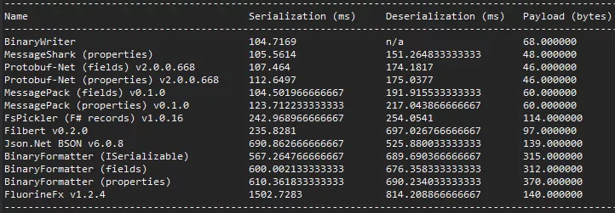
http://theburningmonk.com/benchmarks/

Slide 5
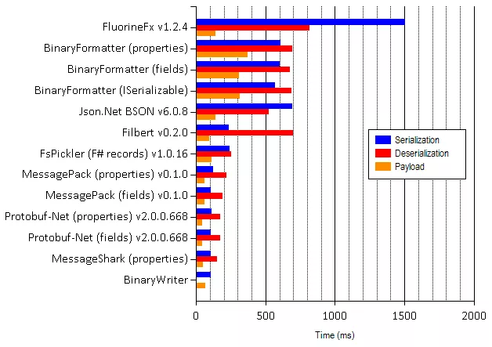
http://theburningmonk.com/benchmarks/

Slide 6
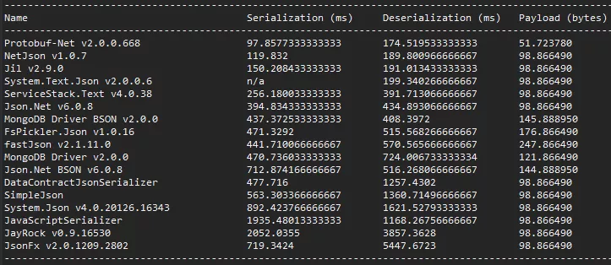
http://theburningmonk.com/benchmarks/

Slide 7
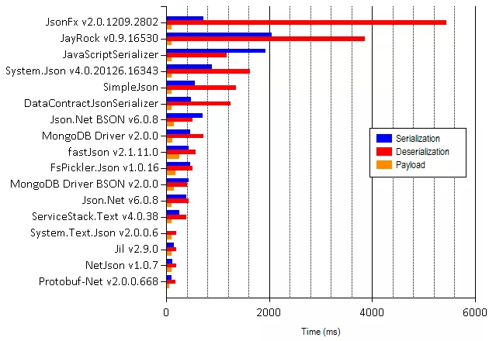
http://theburningmonk.com/benchmarks/

Slide 8
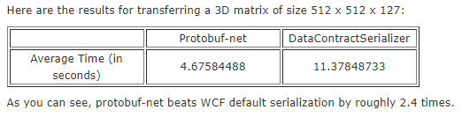
https://whinery.wordpress.com/2014/10/28/wcf-with-protobuf-serialization/

Slide 9
Made up of 3 things
Schema described in .proto files
protoc
Serializer
Notes:
Dive into each one of these next

Slide 10
Schema descriptions
syntax = "proto2"; message Point { required int32 x = 1; required int32 y = 2; optional string label = 3; } message Line { required Point start = 1; required Point end = 2; optional string label = 3; } message Polyline { repeated Point point = 1; optional string label = 2; }
Messages represent objects
Properties are prefixed with keywords: required, optional, repeated, or reserved
The identifier assigned is extremely important
Compiles into many languages
Notes:
Extensible (property in Line is a Point which is another message description)
Easy to validate and modify schema
This is a good way to share schema with other teams. Especially teams that cross language boundaries.

Slide 11
protoc
Converts .protos into classes
Download from protobuf website
In command prompt run
protoc -I=<src dir> --csharp_out=<dest dir> <proto file>
For other languages use swap out the --csharp_out parameter
Ex: --java_out
Notes:
If everything you do is in .NET you don't necessarily need proto files or to use protoc!
Protobuf-net has a program called “precompile” that does the same thing but it’s not well documented and hasn’t been updated in a while. I don’t think it can do proto3.

Slide 12
Serializer
In .NET there are 2 main libraries
Official Google one - Jon Skeet
Protobuf-net - Marc Gravell
Wide support in other languages:
Java, Python, C++, Go...
Notes:
Protobuf-net is better

Slide 13
Demos

Slide 14
Who uses protobuf?
Google
Twitter
LSQ
Derive Systems
Pokemon Go
StackExchange.Redis.Extensions

Slide 15
Questions?
Contact info:
Rush Frisby
rush@rushfrisby.com

